Slide 1
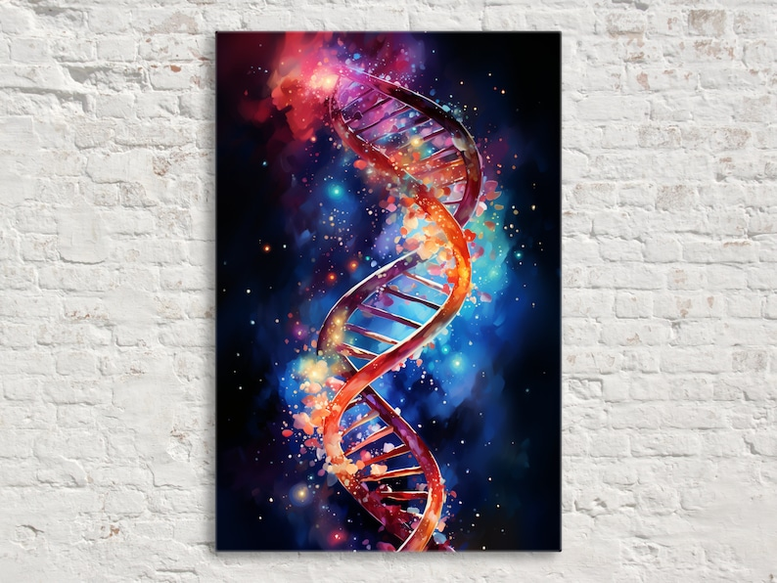
Lecture 6 Register at: Lecture registry
Genetic Algorithms (GA)
Objectives
Introduction
GA terminology
Genetic operators
Example: Fitness proportional selection

Slide 2
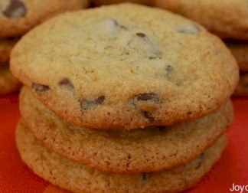
Introduction
flour
1
2
3
4
5
6
7
8
9
1
1
2
3
4
5
4
3
2
1
2
2
3
4
5
6
5
4
3
2
3
3
4
5
6
7
6
5
4
3
4
4
5
6
7
8
7
6
5
4
sugar
5
5
6
7
8
9
8
7
6
5
6
4
5
6
7
8
7
6
5
4
7
3
4
5
6
7
6
5
4
3
8
2
3
4
5
6
5
4
3
2
9
1
2
3
4
5
4
3
2
1
Fig. 1. The Cookie problem - the axes are the amounts (in kilos) of flour and sugar per batch – giving the cookies quality value (0 to 10) in the cells.

Slide 3
flour
quality (fitness) value
sugar
5
4
2
Fig. 1a. A chromosome for the Cookie problem (two genes) with its quality (fitness) value.
For example, a combination 4:2 (4 kilos of sugar and 2 kilos of flour) is evaluated with a quality value of 5 (fig.1).
Many (AI) problems can be formulated in terms of search.
Usually, each candidate solution is associated with some measure or metric of how good it is:
objective function;
cost function;
error measure (loss function), RMS (root of mean squared error), MAE (mean absolute error), Cross-entropy etc.

Slide 4

flour
1
2
3
4
5
6
7
8
9
1
1
2
3
4
5
4
3
2
1
2
2
0
0
0
0
0
0
0
2
3
3
0
0
0
0
0
0
0
3
4
4
0
0
7
8
7
0
0
4
sugar
5
5
0
0
8
9
8
0
0
5
6
4
0
0
7
8
7
0
0
4
7
3
0
0
0
0
0
0
0
3
8
2
0
0
0
0
0
0
0
2
9
1
2
3
4
5
4
3
2
1
Fig. 1b. The function related to the Cookie problem exhibits a moat (mutation that changes a gene by 1 place will not work). Crossover or random number mutation may help to ‘jump over’ the moat (a ‘Mexican Hat’ function).

Slide 5
Heuristic (stochastic, probabilistic) search (exhaustive search is not possible), finding a solution for just the states that are reachable from the initial state, using an optimal ‘heuristic’ strategy.
Deterministic search – strict conditions for the optimized function (continuous (Lipschitz continuity), differentiable, etc.). Local minima (maxima) problem.
Heuristic (evolutionary) optimization methods as GAs, Simulated Annealing, Differential Evolution, Tabu Search, PSO (particle swarm) , ACO (ant colony), BCO (bee colony), AIS (immune system), and a variety of random search techniques have been originally developed for solving combinatorial optimization problems. Later applied to continuous and mixed-discrete variables problems.
17/02/2026
5

Slide 6
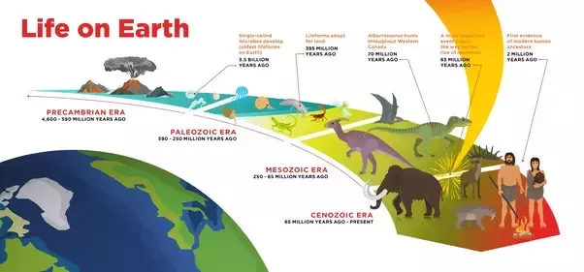
GAs are search techniques inspired by the evolution and principle of natural selection and natural genetics.
Fig. 2. The evolution of ‘Genus Homo’, started about 1.8 million years ago in East Africa (beginning of the stone age). Recent discovery – 2.4 million-year-old tools in North Africa (Algeria).
17/02/2026
6

Slide 7

‘Homo Sapiens’ evolved about 200 000 years ago. There were 6 other human types (all extinct), e.g., Neanderthals in Europe (extinct about 30 000 years ago) interbred with the ‘HS’).
Ancient DNA analysis has led to the discovery of two new extinct human species Homo Izonensis and Denisovans - modern humans carry a substantial amount of their DNA.
New techniques help scientists to analyze microscopic traces of DNA found in cave soils Neanderthals urinated in - no teeth or bones required.

Slide 8
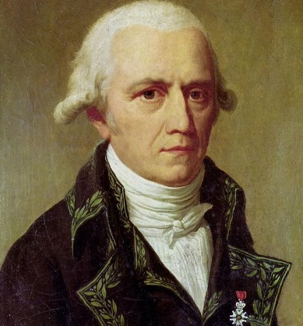
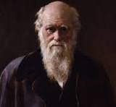
Lamarckism vs Darwinism (inheritance of acquired characteristics vs natural selection).
Lamarckism - organisms can acquire traits in their lifetime to be better suited to their environment and can pass them to the next generation (or acquired changes in the phenotype in one generation, can be inherited in the next). Supports a vital internal force present in living organisms.
Darwinism - supports natural selection, organisms possess variation (each individual is slightly different) and these variations lead to some being more likely to survive and reproduce than others. Therefore, features (chromosomes, genes) that made an organism more likely to survive or reproduce are more likely to appear in the next generation.
Genetics later ultimately showed that all inherited traits are passed on through genes (genotype), which are not affected by outside world (as Lamarckism predicts), and are naturally varied, as Darwin predicted.

Slide 9
John Holland, K. DeJong, D. Goldberg: mid-70s.
GA are inspired by the evolutionary biology, including recombination, mutation, inheritance, and selection:
Evolution operates on chromosomes ;
Chromosomes are strings of genes ;
Each chromosome is assessed with a fitness ;
Less fit chromosomes do not survive due to natural selection (survival of the fittest);
New generation (offspring) inherits properties from the old generation (parents) by reproduction;
More successful (better fit) chromosomes reproduce more.
17/02/2026
9

Slide 10
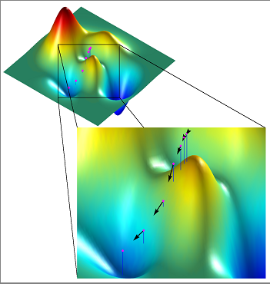
GA combine the effect of selection with structured, randomised recombination of genetic material to perform robust search.
Fig. 3. Deterministic search (minimization) - local minima (maxima) problem.

Slide 11
Heuristic (stochastic) search (exhaustive search is not possible).
Fig. 4. Even in a 2-dimensional optimization problem the search space can be highly complex.

Slide 12
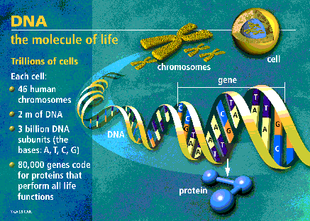
2. GA terminology
Fig. 5. The double helix of DNA (Deoxyribonucleic acid) – the molecule of life, which contains the genetic instructions for the development and function of living organisms. Each cell of human body contains 23 pairs (one inherited from the mother and one from the father) of chromosomes. A gene is a small section of DNA on a chromosome.

Slide 13
100*11
100011
011011
An allele (ə’liː:l) - particular set of values for a gene (e.g., eye colour).
The genes
(features, traits)
The locus of the second gene is 7.
Fig. 6. A Chromosome.
In bio-systems chromosomes are made up of genes (blocks of DNA). Generally, each gene (or a combination of genes), encodes a feature (trait), e.g., the eye colour. FOXP2 gene - speech and language, or Plin2 - metabolic functions or obesity gene.
Genes can take on a set of values called alleles (can be different for different people, e.g., eye colour). The complete set of genetic material (all chromosomes) is called genome.

Slide 14
UK Biobank has recently released de-identified exome sequencing data on 500,000 participants to approved researchers around the world. Exome sequencing measures the region of the genome involved in coding proteins and enables researchers to identify disease-causing genes for the development of targeted treatments.
Scientists in the USA have used these data to uncover a gene (GPR75) that protects against obesity. Not previously known to play a role in obesity, GPR75 is part of a group of genes which encode receptors in the brain responsible for regulating energy balance. This is an exciting link for researchers, as these genes are associated with appetite control, food preferences and even levels of physical activity.
Individuals with at least one inactive copy of the gene have, on average, a lower BMI and tend to weigh about 12 pounds less than those without the mutation. Scientists are now pursuing multiple therapeutic approaches to safely replicate the effect of this genetic mutation for personalised treatments.

Slide 15
The position of a gene is called a locus.
GAs maintain a set of possible solutions (structures), called a population.
Each candidate solution is a string of symbols (most common are 0 and 1, (could be real numbers as well)).
Each string of symbols (candidate solution) is known as a chromosome (fig.6).
Each chromosome is evaluated using a fitness function and assigned a value known as its fitness value (at each iteration called generation).
The fitness value is used to determine:
chromosome's rate of reproduction;
chromosome's life span (whether it will survive).
17/02/2026
15

Slide 16
GA solve problems by iteratively generating and testing candidate solutions (chromosomes).
The next generation chromosomes are produced by selecting ones from the current population (on the basis of their fitness values) and recommending them to reproduce new ones (a Darwinian survival).
Thus, the population is improved from one generation to the next through reproduction using genetic operators and fitness based selection.
The new chromosomes are called offspring.
17/02/2026
16

Slide 17
GA differ from most of the searching techniques in:
Instead of using parameters themselves, classical GA work with a coding of the parameter set;
Instead of starting from a single point, they start the search with a population of points;
They use fitness (objective) function to direct their search, not auxiliary information (e.g., no derivatives);
They use heuristic transition rules (improve their solutions by recombining good ones), and not deterministic ones (which need special conditions for convergence to a global optimum).
17/02/2026
17

Slide 18
A Simple GA
Code the problem parameter set as a set of chromosomes (starting population).
Let P(t) be the state of population P at time t.
Initialise P(t=0) (starting population P(0));
Evaluate P(t=0) (evaluate each member fitness);
repeat
t = t + 1;
generate P(t) from P(t-1) (based on fitness)
evaluate P(t);
until (best fit chromosome found or the stopping condition is satisfied).
17/02/2026
18

Slide 19
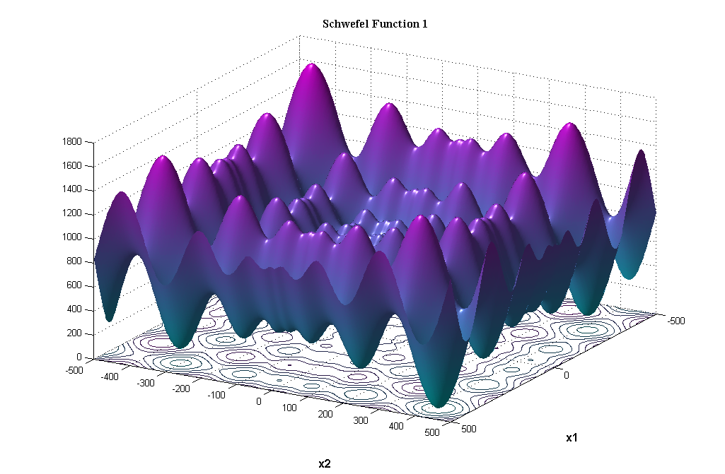
GA perform the search using a fitness function as a metric, and not additional information (derivatives) - in this sense they are blind (“The blind watchmaker”, R. Dawkins).
In a biological system, a genotype is the total genetic package. The organism produced by the genotype is called a phenotype (its expression).
Phenotype (problem space)
Genotype (solution space)
Encoding
(representation)
10010001
10010010
010001001
Decoding
(inverse representation)
011101001
Fig. 7. Two spaces in the classical GA.
17/02/2026
19

Slide 20
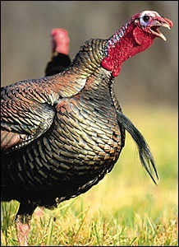
Example: Representation/coding of behaviour (coding Turkey-mother behaviour)
Turkey-mothers are fierce protectors of their young. They need to protect them against nest marauders like weasels or scavenging rats. The "rule of thumb" a turkey mother uses to recognise nest robbers is: "In the vicinity of your nest, attack anything that moves, UNLESS it makes a noise like a baby-turkey." This was discovered by an Austrian zoologist named Wolfgang Schleide. Schleide once had a mother-turkey that savagely killed all her own babies.
The reason was very simple - she was deaf. Predators, as far as the turkey's nervous system is concerned, are defined as moving objects that don't emit a baby's cry. These baby-turkeys that look like baby turkeys, move like baby turkeys, and run trustingly to their mother like baby turkeys, fell victim to the mother's restricted definition of a predator. And she massacred them all.“
(From "River Out of Eden - A Darwinian View of Life" by Richard Dawkins.)

Slide 21
Moving
Baby- noise
Nest vicinity
On the ground
Large
Feed
Attack
Input
Output
*
1
1
*
0
1
0
If the object is making baby-turkey noise, in the nest, and small: - feed.
*
0
0
*
*
0
0
If the object doesn't make baby-turkey noise and far: - ignore.
1
0
1
1
*
0
1
If the object is moving, doesn't make baby-turkey noise, close, on the ground: - attack.
Fig. 8. Example of coding (7 bit representation) of a TurkeyMother system. Depending on an object's movement, noise making, location, size, etc. attributes (input), the turkey would feed, attack, or ignore it (output). The string with the fewest "*" (don't care) governs the system's action.

Slide 22
GA reproductive operators
Crossover
This is the most commonly used operator. It produces two offspring from a pair of strings (chromosomes) by exchanging portions of the pair using randomly chosen point, called crossover point (site).
Fig. 9 shows one-point crossover (two-point, or more, are possible).
The crossover allows pieces of information to be re-distributed throughout the population.
Offspring produced by crossover cannot contain information that is not already in the current population.
17/02/2026
22

Slide 23
randomly chosen single crossover point = 4
parent 1 chromosome
parent 2 chromosome
aaeebbbb
cccchhhh
cccc
bbbb
aaee
hhhh
offspring 1
offspring 2
building block ee transferred without change
Fig. 9. Crossover operator. Building blocks with high fitness transferred and accumulated together to give high fitness of the offspring chromosome.
17/02/2026
23

Slide 24
For example, considering the Cookie problem from Fig.1, if we crossover chromosome 52 (fitness 6) and chromosome 14 (fitness 4), we would receive two offspring: chromosomes 54 (fitness 8) and 12 (fitness 2).
flour
1
2
3
4
5
6
7
8
9
1
1
2
3
4
5
4
3
2
1
2
2
3
4
5
6
5
4
3
2
3
3
4
5
6
7
6
5
4
3
4
4
5
6
7
8
7
6
5
4
sugar
5
5
6
7
8
9
8
7
6
5
6
4
5
6
7
8
7
6
5
4
7
3
4
5
6
7
6
5
4
3
8
2
3
4
5
6
5
4
3
2
9
1
2
3
4
5
4
3
2
1
17/02/2026
24

Slide 25
Multiple point crossover is also possible, but the chance of splitting building blocks increases.
Crossover may interfere with the exploitation of a building block by breaking it up, but it also produces new blocks, which allow new regions to be tested (exploration).
This way crossover determines a balance between exploitation and exploration in the search.
17/02/2026
25

Slide 26
Mutation
Mutation is a secondary search operator, which is used as an insurance policy against the irreversible loss of genetic material (helps diversity and exploration).
Unary operator - it generates one offspring by randomly changing the values of the genes (features).
Generally, it supports more the exploration by introducing randomness in the search.
If a string Z = 10010111
is undertaking mutation at randomly selected positions 2 and 6 (with some probability), then the offspring could be
O = 11010011 .
17/02/2026
26

Slide 27
parent chromosome
abcdefg
mutate 2 random symbols from set a, b, d, e
child chromosome
ebcdafg
Fig. 10. The mutation operator.
Good effect: - allows local minima to be escaped (the search ‘jumps’ to new sub-regions).
It guarantees that the probability of searching a particular sub-region of the solution space is not a zero.
Bad effect: - splits useful building blocks, but fitness selection will eliminate the poorly fit offspring.
17/02/2026
27

Slide 28
Example
When individuals are represented as chromosomes, mutation can be implemented in the following way:
firstly, fix a mutation rate p, then;
change the value of each gene with probability p.
Mutation is often applied to each bit with probability
p =1/(total number of bits),
e.g., for 10 chromosomes (individuals), each of 8 bits: p = 1/(10*8)=0.0125 per bit.
What is the probability of a chromosome containing 2 genes (each of 4 bits), not to be changed by mutation, in a population of 20 chromosomes? (1 – 1/(2*4*20))= 1-0.00625= 0.99375
17/02/2026
28

Slide 29
Example: Fitness proportional selection (FPS)
Review of some basic statistics
If we have a set of n numbers, for example, x = 2, 9, 1, 5, 3, (sample size n=5) then:
The Mean (average) is:
Don’t confuse it with a median, which is 3 in this case.
In Matlab, if you assign x=[2, 9, 1, 5, 3] and then call the mean function with mean(x), you should get the same result.

Slide 30
The Standard deviation is a measure of the variation of the set, or how close to the mean are all members of the set (same unit measures):
Again, should get the same result if you use Matlab std(x) function.
The Variance is the squared standard deviation:
In Matlab: var(x) .
it weights the outliers more heavily than the data near the mean (squared unit measures).

Slide 31
A simple GA using FPS
Example.
Maximise the function:
f(x)=x², x ∈[0, 31].
For simplicity consider only integer values for x.
900
Y = X²
700
500
300
100
X
0
10
20
30
Fig. 11. y = f(x) = x²
In Table 1 (next lecture), each value of x is encoded with a string. The population is a set of individuals, where each individual represents the phenotype (the decoded parameter or parameters) and the genotype (the binary string).
17/02/2026
31

